Slide 1
CSCIU 210 Computer Organization AKM Jahangir A Majumder, PhD
Fall 2018 - Lecture 19
October 10, 2018
Note: Some slides are adapted from those used by previous instructors and some slides include figures from the textbook.

Slide 2
Review and Learning Outcomes
We finished our coverage on Multiplexer, Demultiplexer
We will start to cover simple ALU design today.
build a 32-bit ALU
and, or, nor, add, subtract, and slt (set on less than)
Exam 1 grades and Keys are posted on Blackboard
HW 3 grades are posted on Blackboard
We will have Quiz 4 on Wednesday, October 17, which will cover lecture 16-19
HW 4 will post on Blackboard soon
No Class on Friday, October 12

Slide 3
Summary of Materials We Covered up to Now
So far, we covered the following important concepts:
Fundamental Logic Gates and Some Important Logic Components
Decoder and Multiplexer.
Boolean Algebra
Number Representation with Different Bases
Decimal, Binary, Hexadecimal, Octal.
Binary Addition and Subtraction with the 2’s complement
Overflow Detection
We are going to use the concepts we covered up to now to build a simple ALU (Arithmetic Logical Unit)

Slide 4
ALU Functions
We want to build a 32-bit ALU which can perform the following operations:
and, or, nor, add, subtract, and slt (set on less than)
operation
a
32
ALU
result
32
b
32

Slide 5
An ALU (arithmetic logic unit)
Let's build an ALU to support the ‘and’ and ‘or’ functions at the first.
we'll just build a 1 bit ALU, and use 32 of them
Possible Implementation (sum-of-products):
operation
op
a
b
res
a
b
ALU
result

Slide 6
Review: The Multiplexor
Selects one of the inputs to be the output, based on a control input
Lets build our ALU using a MUX:
S
A
0
C
B
1
note: we call this a 2-input mux even though it has 3 inputs!

Slide 7
The one-bit ALU Implementation with a MUX
S=0⇒ Output, c =(A⋅B)
S=1 ⇒ Output, c=(A+B)
S (Operation)
B
A
A⋅B
0
1
C
A+B

Slide 8
Different Implementations
Not easy to decide the “best” way to build something
Don't want too many inputs to a single gate
Don’t want to have to go through too many gates
For our purposes, ease of comprehension is important
Let's look at a 1-bit ALU for addition: How could we build a 1-bit ALU for ‘add’, ‘and’, and ‘or’?
How could we build a 32-bit ALU?

Slide 9
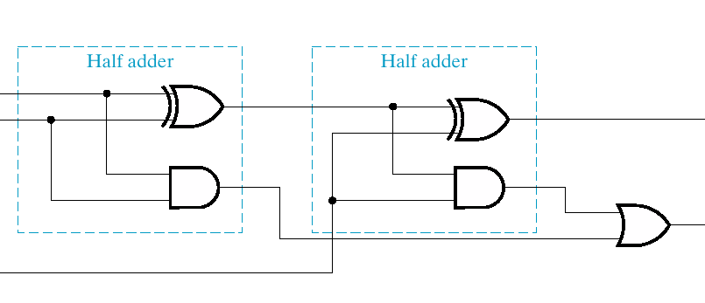
Review: 1 bit Full Adder Implementation
a
sum
b
carry out
carry in
sum
=
a
⊕
b
⊕
c_{in}
c_{out}
=
a
b
+
(
a
⊕
b
)
c_{in}

Slide 10
Review: Functional Block of Full-Adder
A full adder is similar to a half adder, but includes a carry-in bit from lower stages. Like the half-adder, it computes a sum bit, S and a carry bit, C.
For a carry-in (Z) of 0, it is the same as the half-adder:
For a carry- in (Z) of 1:
Z
0
0
0
0
X
0
0
1
1
+ Y
+ 0
+ 1
+ 0
+ 1
C S
0
0
0 1
0 1
1 0
Z
1
1
1
1
X
0
0
1
1
+ Y
+ 0
+ 1
+ 0
+ 1
C S
0 1
1 0
1 0
1
1

Slide 11
1-bit Full Adder Symbol

Slide 12
Building a 32 bit ALU with ‘and,’ ‘or,’ and ‘add’ Functions
How many bits do we need to represent ‘operation’?

Slide 13
What about subtraction (a – b) ?
Two's complement approach: just negate b and add.
How do we negate?
A very clever solution:
Invert every bit of bi
Set Carry in as 1 for the
Least Significant Bit (LSB).
We are going to cover
how to wire inputs later.

Slide 14
Review: Least Significant Bit and Most Significant Bit
1000 0011 0011 0011 1101 1010 0011 0011
Most Significant Bit
(MSB)
Least Significant Bit
(LSB)

Slide 15
Adding a NOR function
A nor function can be represented as (A+B)’=A’⋅B’ (It is called DeMorgan’s law)
A | B | (A+B)’ | A’B’
0 | 0 | 1 | 1
0 | 1 | 0 | 0
1 | 0 | 0 | 0
1 | 1 | 0 | 0

Slide 16
DeMorgan’s law
(A+B)’=A’⋅B’
(A⋅B)’=A’+B’ (Prove it with truth table!)

Slide 17
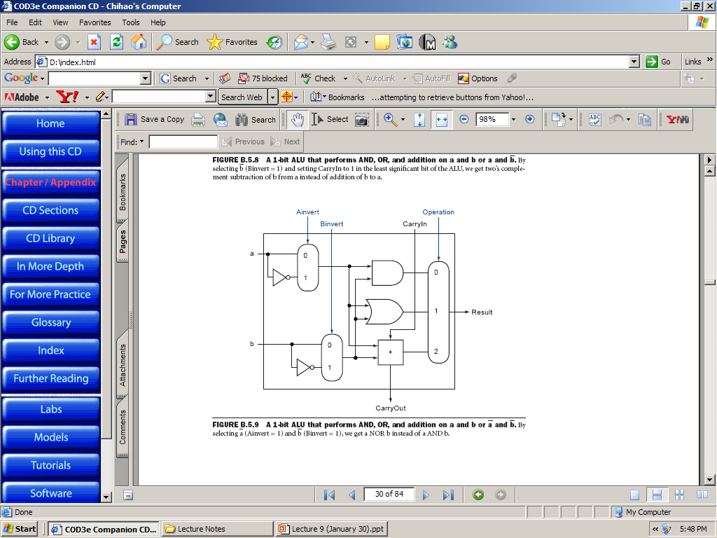
The NOR Function Implementation
Suppose that we can also choose to invert a. How do we get “a NOR b” ?

Slide 18
Set-on-less-than (slt) Function
Set-on-less-than (slt) is an important MIPS functions.
The MIPS command,
‘slt $s1, $s2, $s3,’ means
If ($s2 < $s3), then $s1=1 else $s1=0.

Slide 19
slt Function Implementation
Our ALU needs to support the set-on-less-than instruction (slt)
remember: slt is an arithmetic instruction
produces a 1 if a < b and 0 otherwise
use subtraction: (a-b) < 0 implies a < b
We can also support equality test
use subtraction: (a-b) = 0 implies a = b

Slide 20
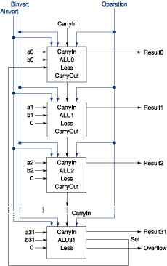
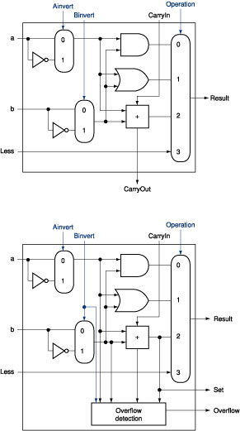
Slt Function Implementation
0
1
11
(ALU 0~30)
Perform a-b
Output MSB from ALU 31 to ALU 0
Op ’11’ is used to chose output
0
1
11
(ALU 31)

Slide 21
An 32-bit ALU Supporting slt function

Slide 22
The 1-bit ALU for the Most Significant Bit

Slide 23
The 1-bit ALU for Other Bits

Slide 24
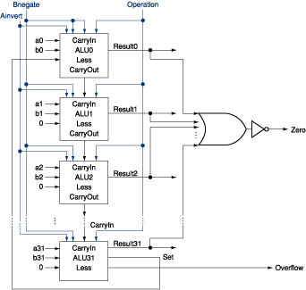
Final 32-bit ALU with a Zero Detector
ALU control lines: 0000 = and 0001 = or 0010 = add 0110 = subtract 0111 = slt 1100 = NOR
Note: zero is a 1 when the result is zero!

Slide 25
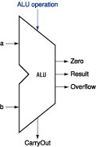
Our 32-bit ALU Symbol
ALU control lines: 0000 = and 0001 = or 0010 = add 0110 = subtract 0111 = slt 1100 = NOR

Slide 26
The ALU Diagram
ALU control lines: 0000 = and 0001 = or 0010 = add 0110 = subtract 0111 = slt 1100 = NOR
ALU 0~30
ALU 31
Can this ALU implement a NAND function?

Slide 27
Question regarding ALU
Among 6 functions (‘and’, ‘or’, ‘nor’, ‘add’, ‘sub’, and ‘slt’), our simple ALU capable to handle, which one takes the longest time to finish?

Slide 28
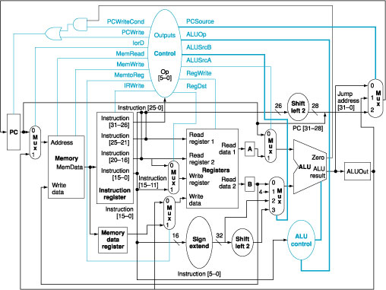
A MIPS Computer Architecture

Slide 29
Summary
Today, we started to cover a simple ALU design

